Slide 1

B-15
Gokaraju Rangaraju Institute Of Engineering And Technology
(Autonomous)
Department Of Information Technology
A Major Project On
Intelligent Intrusion Detection System: Detecting Cyber Threats with Machine Learning
Project Guide:
Team Members:
Munagoti Usha Rani
R.Pratheek Reddy (22241A12B7)
T.Lok Vinay(22241A12C3)
P.Dinesh Reddy (22241A12B5)
Assistant Professor,
Dept. of IT.

Slide 2
Problem Statement:
In today’s interconnected world, computer networks face constant threats from cyberattacks such as Denial of Service (DoS), unauthorized access, privilege escalation, and probing. Traditional Intrusion Detection Systems (IDS) rely heavily on static rules and predefined attack signatures, making them less effective against new or evolving attack patterns. These limitations lead to delayed detection, increased false positives, and potential security breaches.
With the increasing complexity and volume of network traffic, there is a pressing need for an intelligent IDS that can automatically learn patterns of normal and malicious activities from historical data, adapt to emerging threats, and operate in real time. This project aims to address this gap by developing a machine learning-based IDS that uses the NSL-KDD dataset to train and evaluate multiple algorithms, and integrates a web-based interface for easy deployment. The system should provide accurate, scalable, and real-time detection to enhance network security and reduce the risk of cyber intrusions.

Slide 3
ABSTRACT:
The increasing number of cyberattacks in today’s digital world has made network security a crucial concern. Traditional security mechanisms such as firewalls and antivirus software are often insufficient to detect complex and evolving threats. To address this challenge, this project presents a Machine Learning–based Intrusion Detection System (IDS) that efficiently identifies and classifies network traffic as either normal or intrusive.
The system uses the NSL-KDD dataset, a benchmark dataset for intrusion detection research. Data preprocessing techniques such as feature selection, encoding of categorical variables, and normalization were applied to enhance model performance. An XGBoost classifier was trained using the top 10 significant network features, chosen to simplify real-time implementation while maintaining high accuracy.
The trained model is integrated with a FastAPI backend to handle prediction requests and a React-based frontend that allows users to input feature values through an interactive interface. The frontend communicates with the backend via REST API calls, displaying the detection result—Normal or Intrusion—along with graphical visualizations using pie and bar charts for better interpretability.
This IDS project demonstrates an effective and scalable approach for detecting network intrusions with improved accuracy and reduced complexity.
Keywords:
Intrusion Detection System, Cybersecurity, Machine Learning, NSL-KDD, Flask, Real-time Detection, Network Security, Python, Scapy.

Slide 4
Objective :
To design and develop a machine learning-based Intrusion Detection System capable of identifying and classifying network intrusions with high accuracy.
To process and analyse network traffic data to detect both known and unknown attack patterns.
To reduce false positives while ensuring quick and reliable threat detection.
To provide a user-friendly interface for visualizing detected intrusions and system alerts.

Slide 5
Scope Of The Project:
Data Source: Use publicly available datasets such as NSL-KDD or CICIDS2017 for training and testing the IDS.
Techniques: Implement classification algorithms (e.g., Random Forest, Decision Tree, XG Boost, or Neural Networks) for intrusion detection.
Detection Types: Identify multiple categories of attacks such as Neptune, Smurf, Portsweep, Teardrop, Back ,etc.
Deployment: IDS can be implemented as an offline model for testing or integrated into a network monitoring system for real-time detection.
Future Scope: Extend to a real-time intrusion prevention system (IPS) and integrate deep learning for advanced detection.

Slide 6
Proposed Solution :
The proposed Intrusion Detection System (IDS) will leverage machine learning algorithms to accurately identify and classify network traffic as normal or malicious. The solution involves collecting and preprocessing a publicly available dataset, such as the NSL-KDD or CICIDS2017, which contains labelled network traffic data. Feature selection and extraction techniques will be applied to reduce noise and improve detection efficiency.
The processed data will be fed into various machine learning models (e.g., Decision Tree, Random Forest, XGBoost) to train and evaluate their performance. The best-performing model will be deployed as the IDS’s core detection engine.

Slide 7
Required Technologies:
Frontend: HTML, CSS, JavaScript,React.js
⁠ Datasets: NSL-KDD or CICIDS2017
Backend Framework: Flask or FastAPI
AI/ML: Python (Scikit-learn / TensorFlow / PyTorch for anomaly detection & classification)
Networking and Testing Tools : Wireshark, Scapy

Slide 8
Expected Outcome:
Accurate Threat Detection : The system identifies and flags malicious network activities in real-time with high precision.
User-Friendly Interface : A clear, interactive dashboard for monitoring alerts and viewing system status.
Improved Network Security : Strengthens defence mechanisms by enabling proactive response to threats.
Customizable Detection Rules : Allows administrators to adapt the system to evolving cyber threats.

Slide 9
Literature Survey:
Title | Authors | Methodology | Advantages | Disadvantages
Intrusion Detection using Machine Learning Techniques: An Experimental Comparison. (2021) | Kathryn-Ann Tait, Jan Sher Khan, Fehaid Alqahtani, Awais Aziz Shah, Fadia Ali Khan, Mujeeb Ur Rehman, Wadii Boulila, Jawad Ahmad | Experimental comparison of various machine learning algorithms for IDS. | High accuracy in binary classification; multiclass classification provides detailed attack differentiation. | Selection of appropriate algorithm can be challenging; performance varies across different datasets.
A Hybrid Framework for Intrusion Detection in Healthcare. (2022) | MA Kumaar, et al. | Proposed "ImmuneNet," a deep learning-based hybrid framework for IDS in healthcare. | Enhanced detection of latest intrusion attacks; tailored for healthcare data security. | High computational requirements; may require specialized hardware.

Slide 10
Title | Authors | Methodology | Advantages | Disadvantages
Toward Deep Learning based Intrusion Detection System. (2024) | Z Li | Exploration of deep learning techniques for IDS development. | Potential for high detection accuracy; adaptability to evolving threats. | Requires large labeled datasets; training deep models can be resource-intensive.
Federated Learning in Intrusion Detection: Advancements, Challenges, and Future Directions. (2025) | B Buyuktanir, et al. | Review of federated learning applications in IDS. | Enhances privacy by keeping data localized; reduces data transmission overhead. | Complexity in model aggregation; potential issues with data heterogeneity.

Slide 11
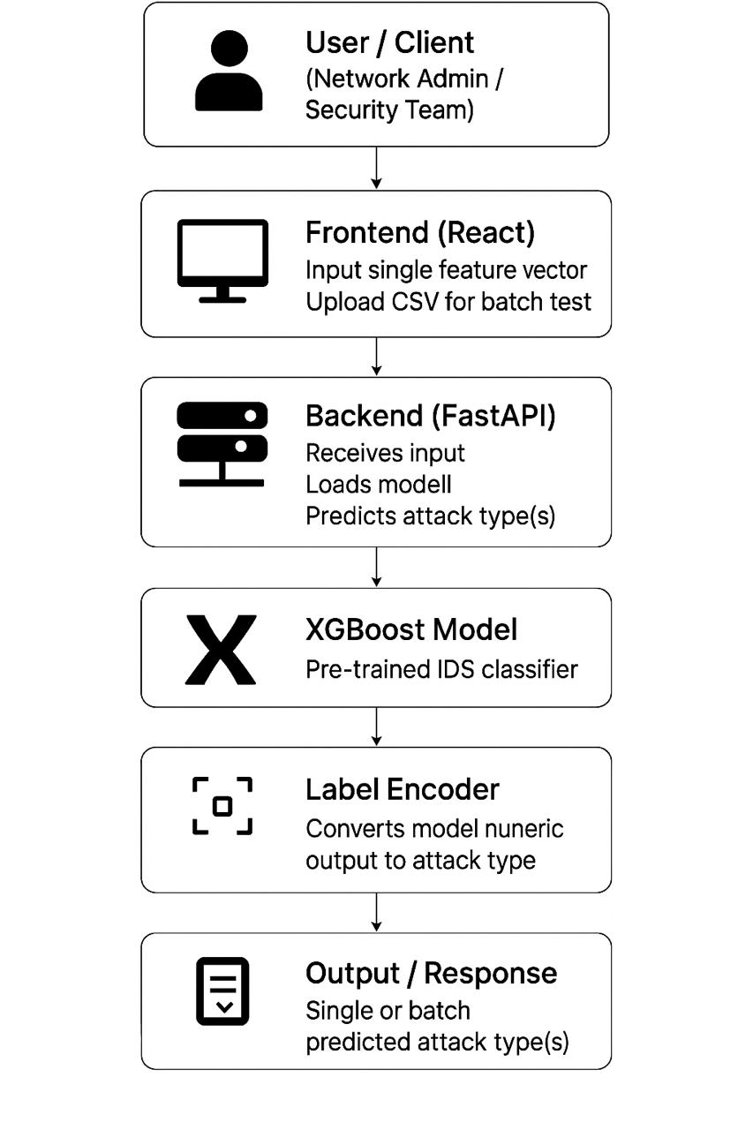
System Architecture :

Slide 12
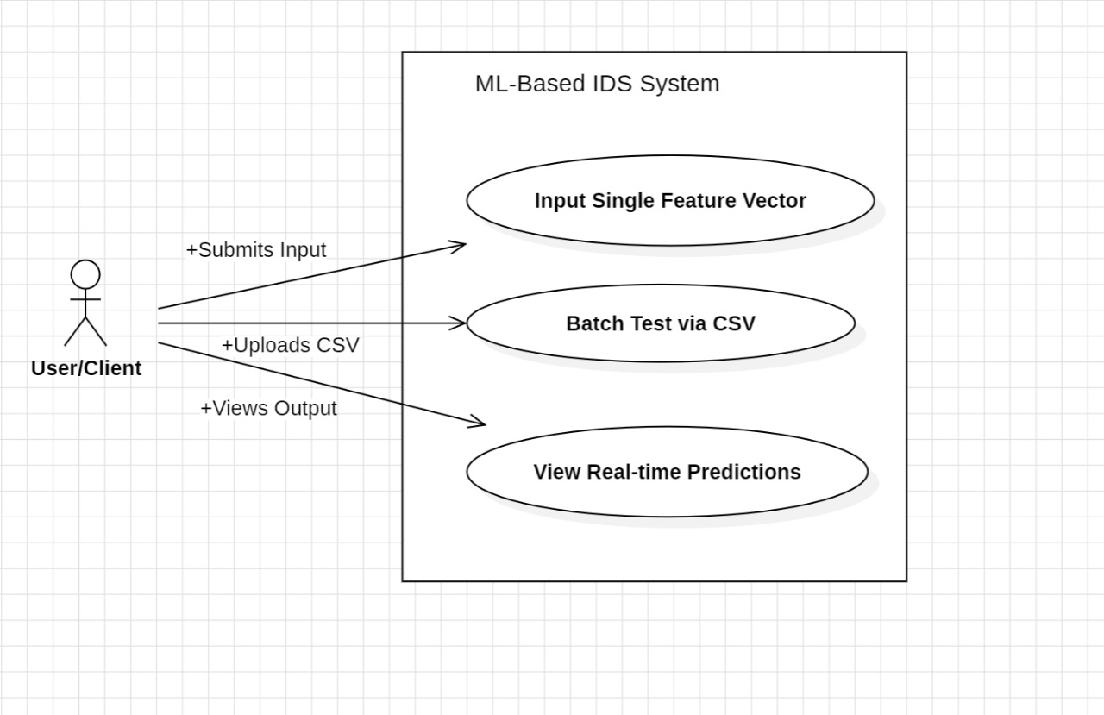
UML Designs:
Use case Diagram :

Slide 13
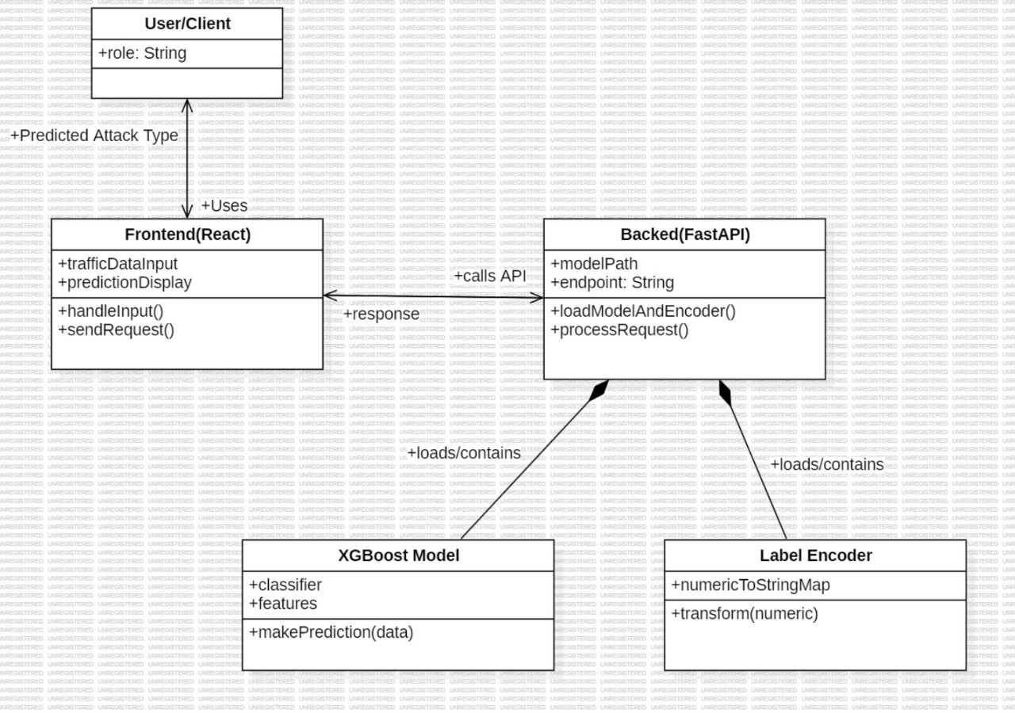
Class Diagram :

Slide 14
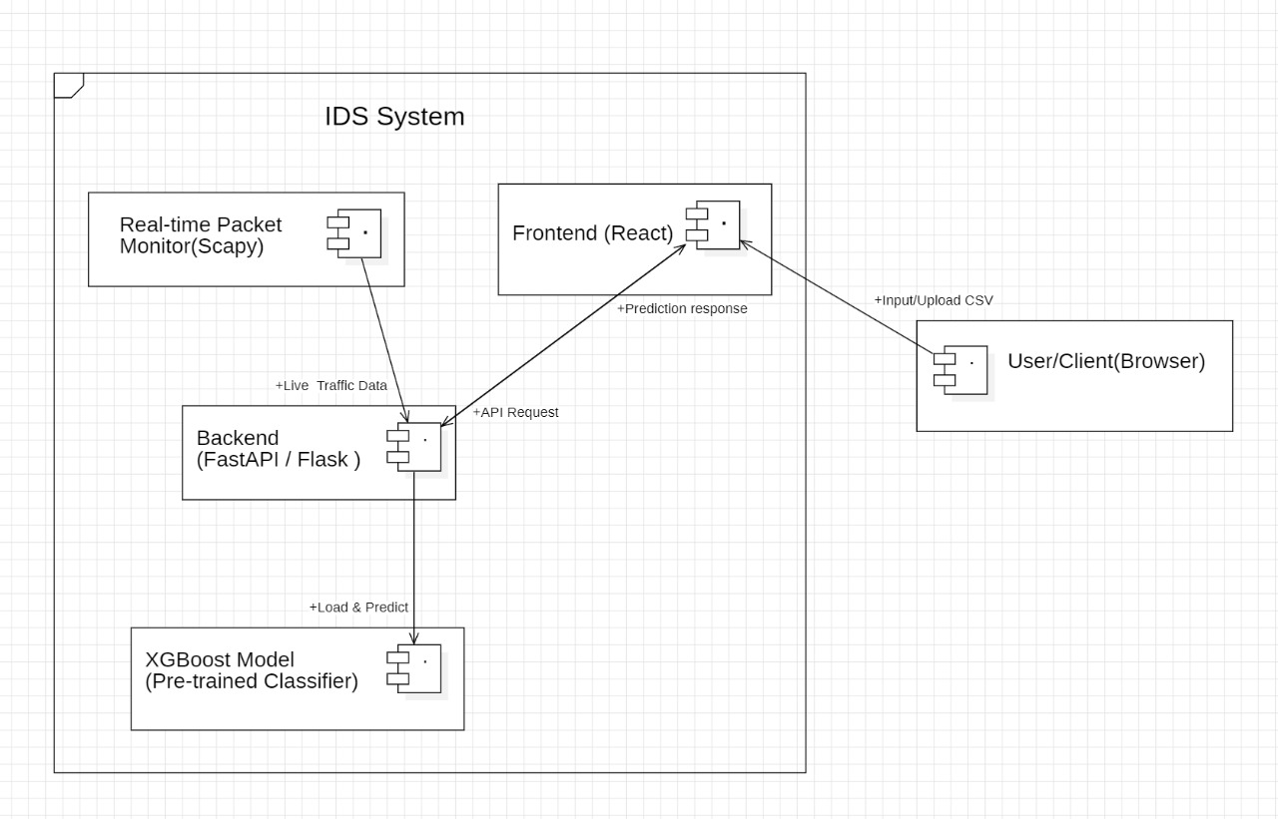
Component Diagram:

Slide 15
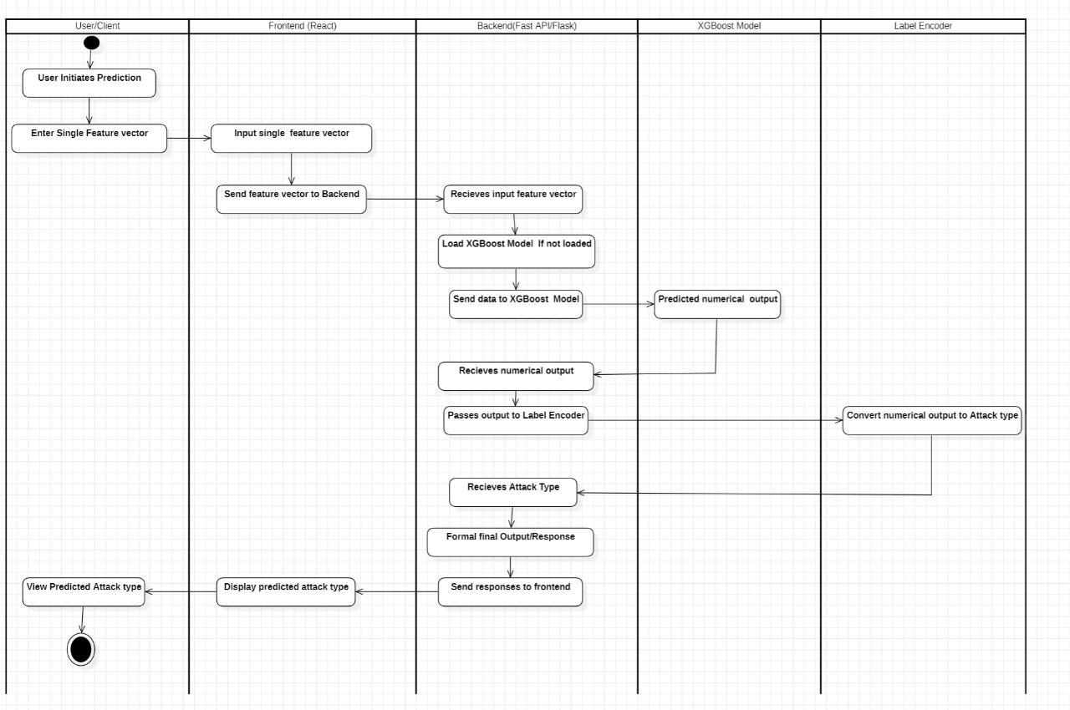
Activity Diagram :

Slide 16
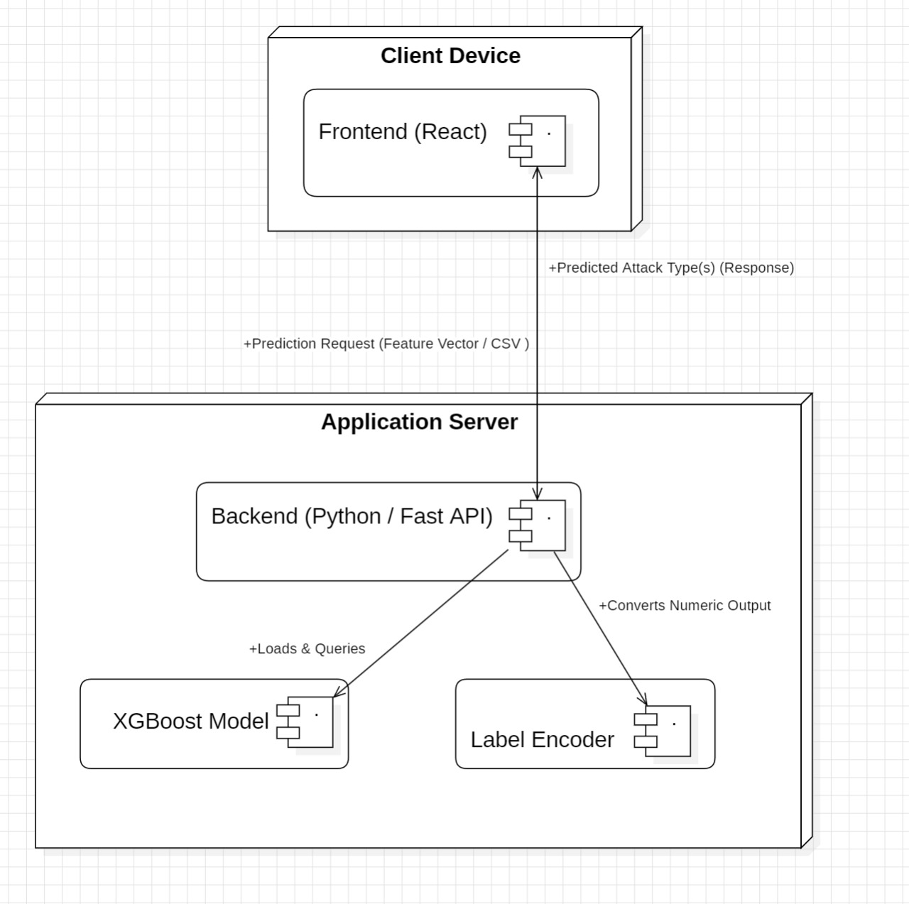
Deployment Diagram :

Slide 17
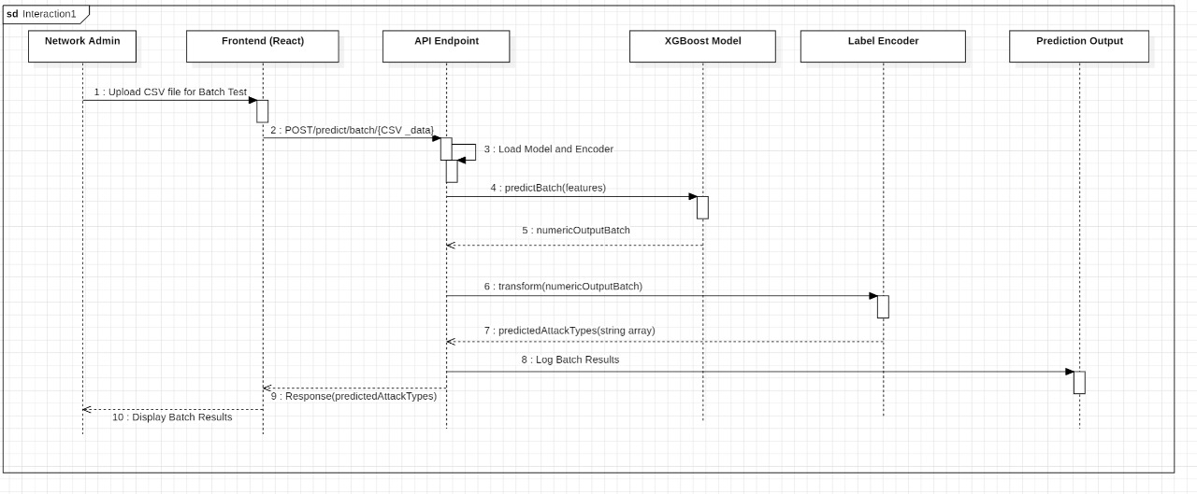
Sequence Diagram:

Slide 18
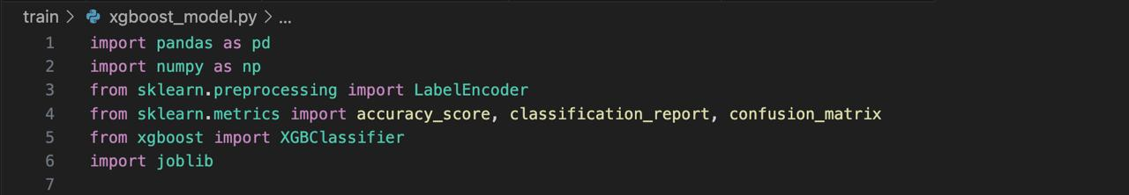
Implementation :
Import Libraries :

Slide 19
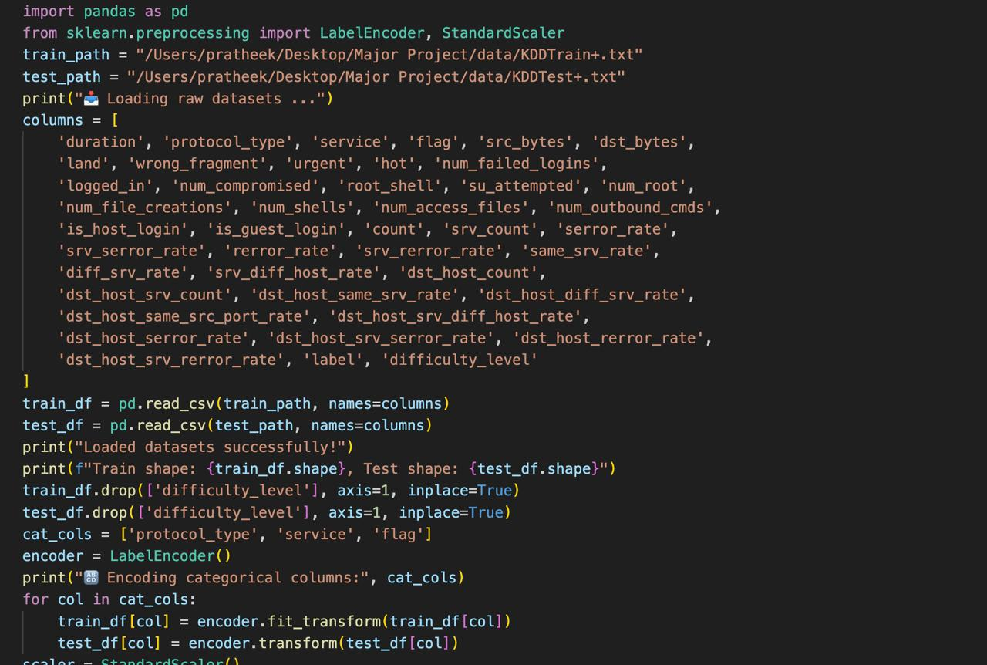
Preprocessing :

Slide 20
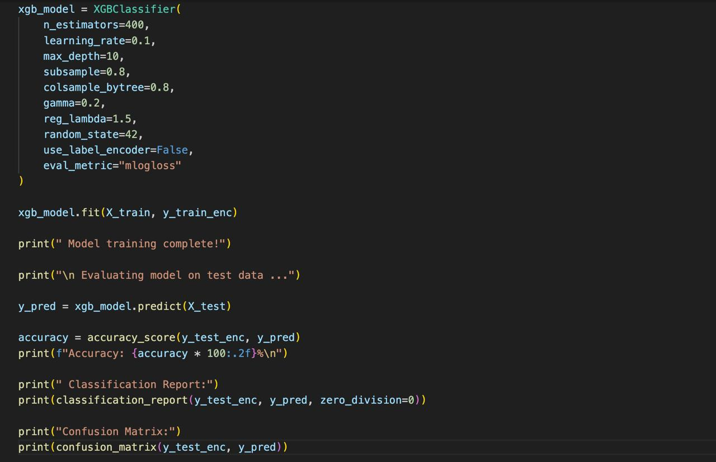
Model Training :

Slide 21
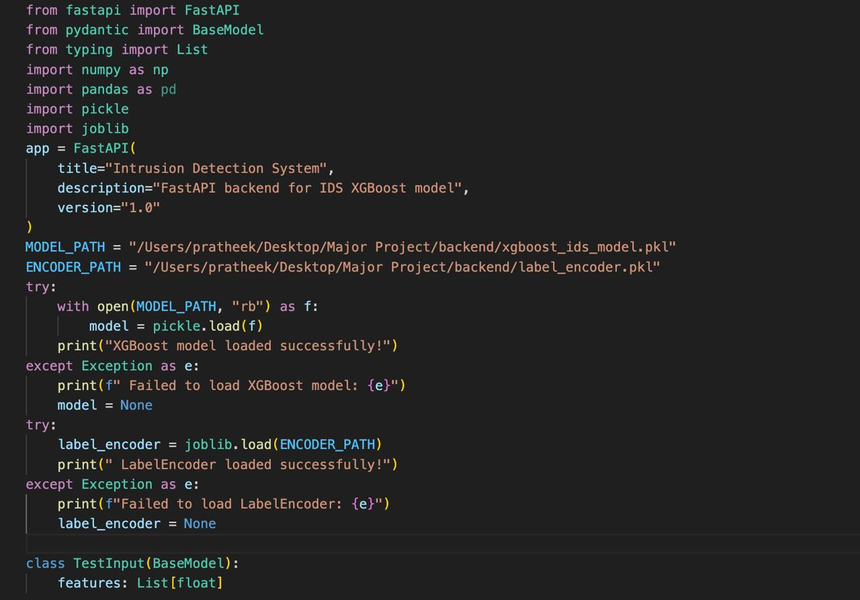
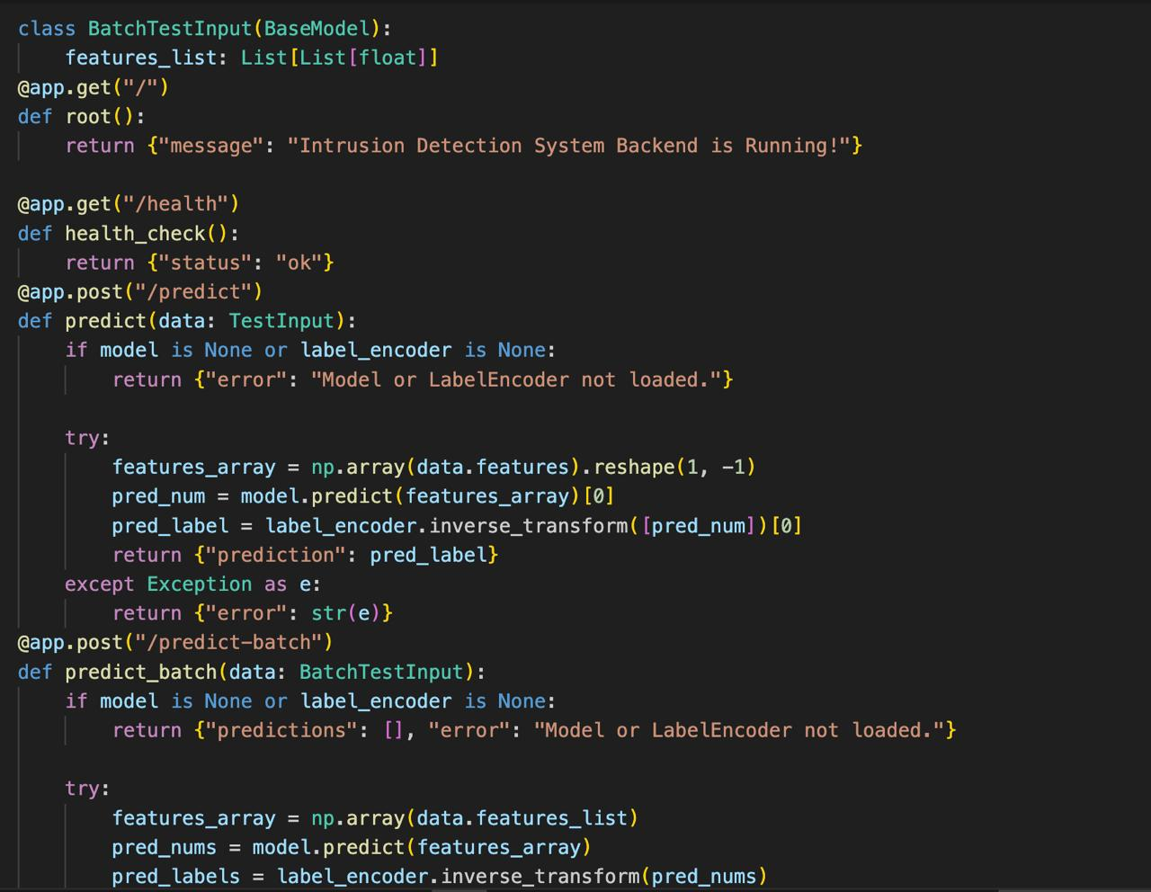
Backend Model Integration :

Slide 22
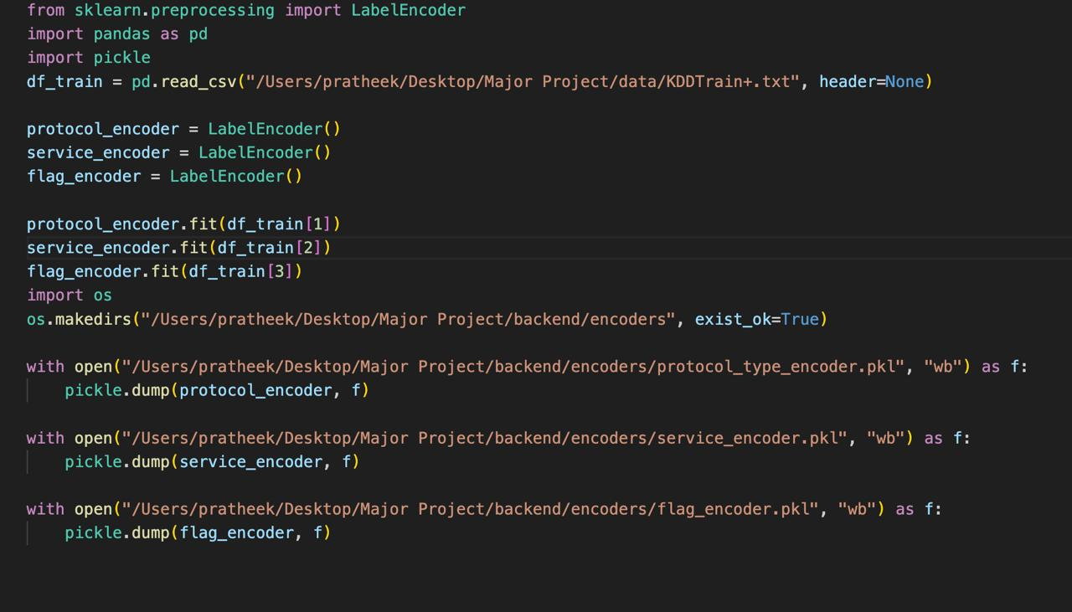
Creating encoders :

Slide 23
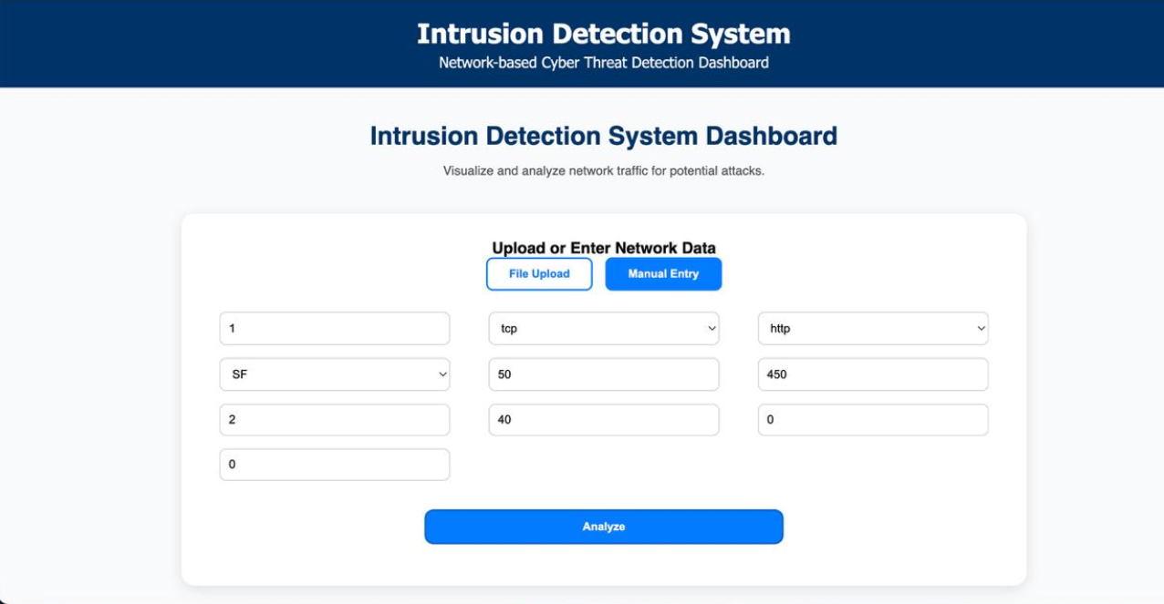
Result :

Slide 24
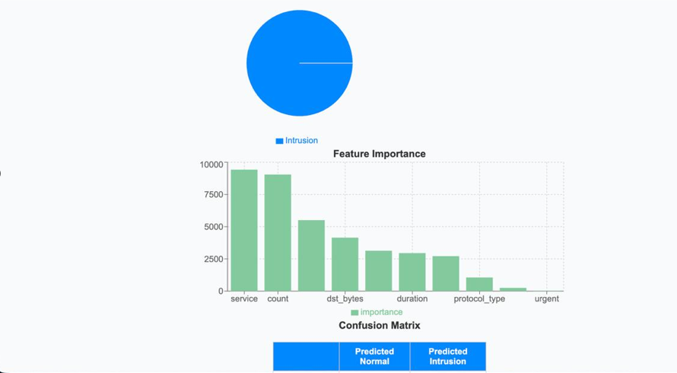
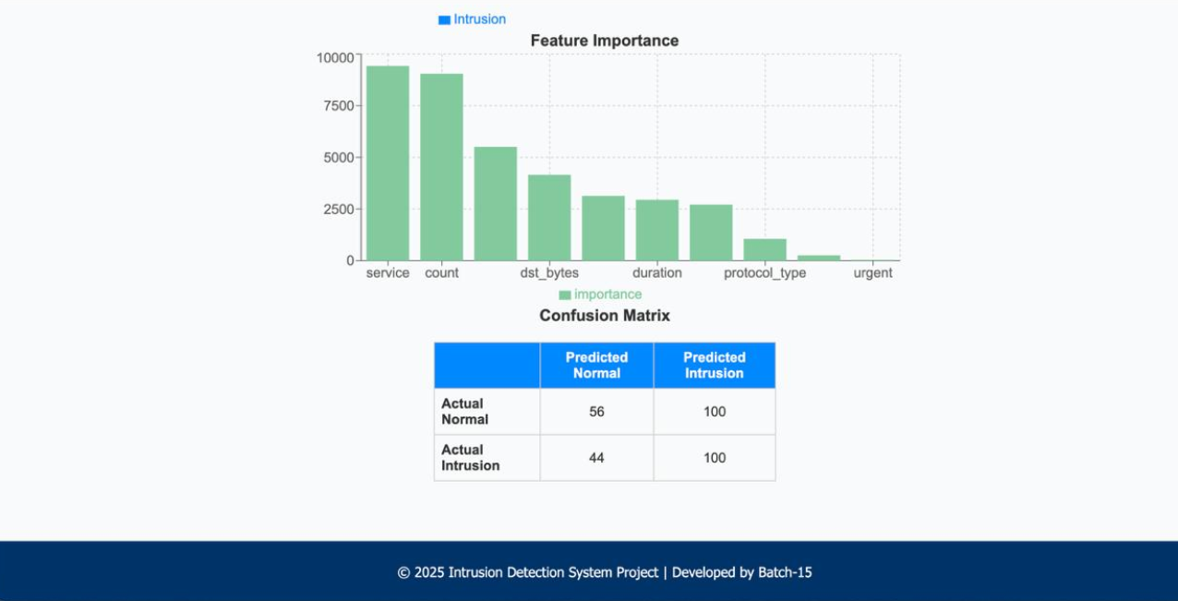

Slide 25
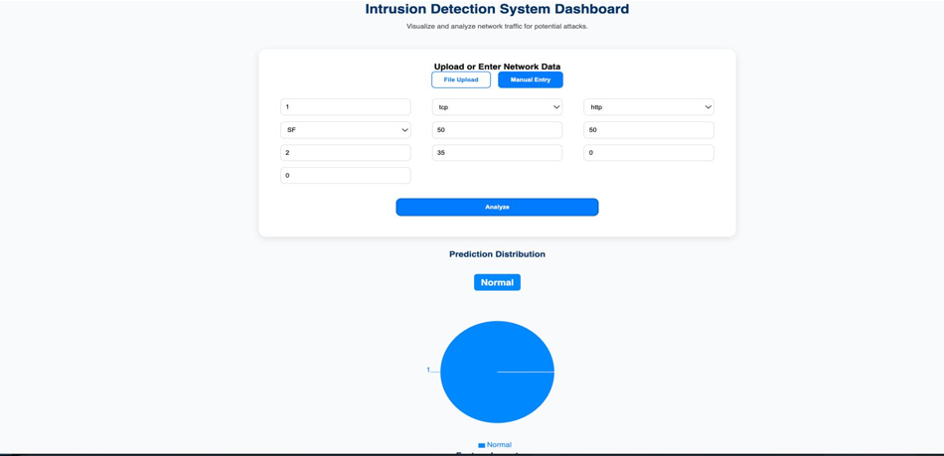

Slide 26
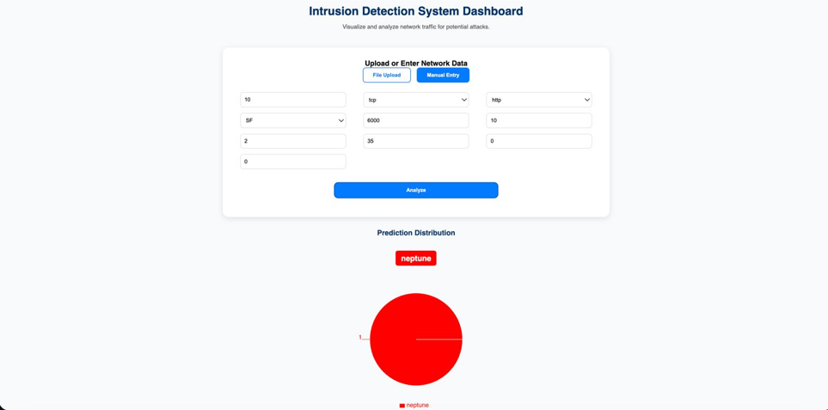

Slide 27
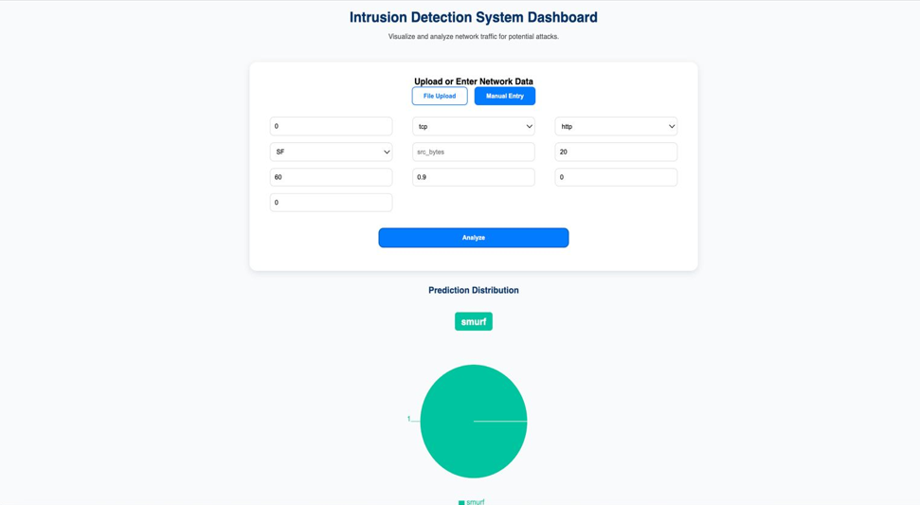

Slide 28
Future Enhancements :
Integration of Deep Learning Models – Use advanced models like CNN or LSTM to improve detection accuracy and adapt to complex attack patterns.
Real-Time Intrusion Detection – Upgrade the system to monitor live network traffic and instantly identify intrusions.
Automated Alert System – Implement real-time notifications (via email or dashboard alerts) when suspicious activity is detected.
Cloud Deployment – Deploy the IDS on cloud platforms for scalability, accessibility, and efficient data handling.
Integration with Firewall or Security Systems – Link the IDS with firewalls or intrusion prevention systems (IPS) for automated blocking of malicious traffic.

Slide 29
THANK YOU

